Slide 1
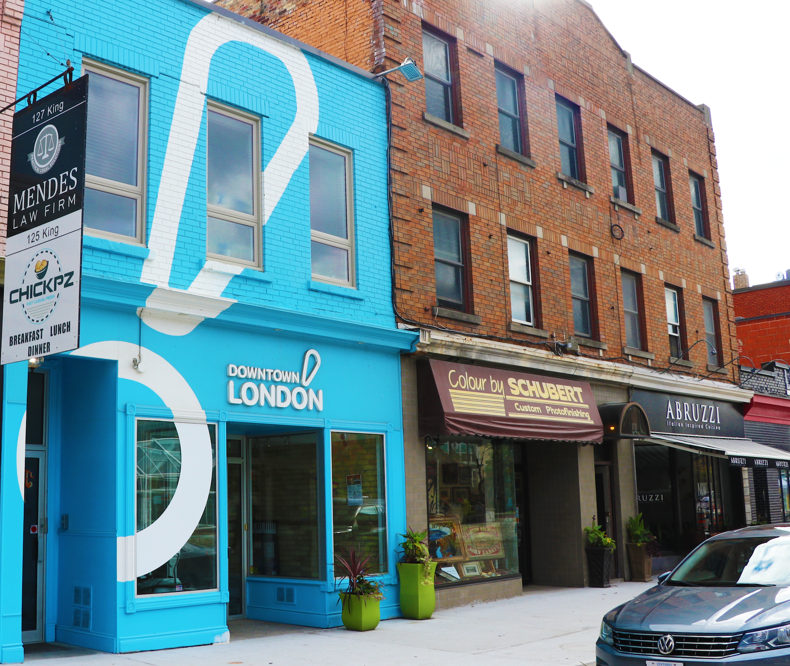

Downtown Reimagined.
Annual General Meeting

Slide 2
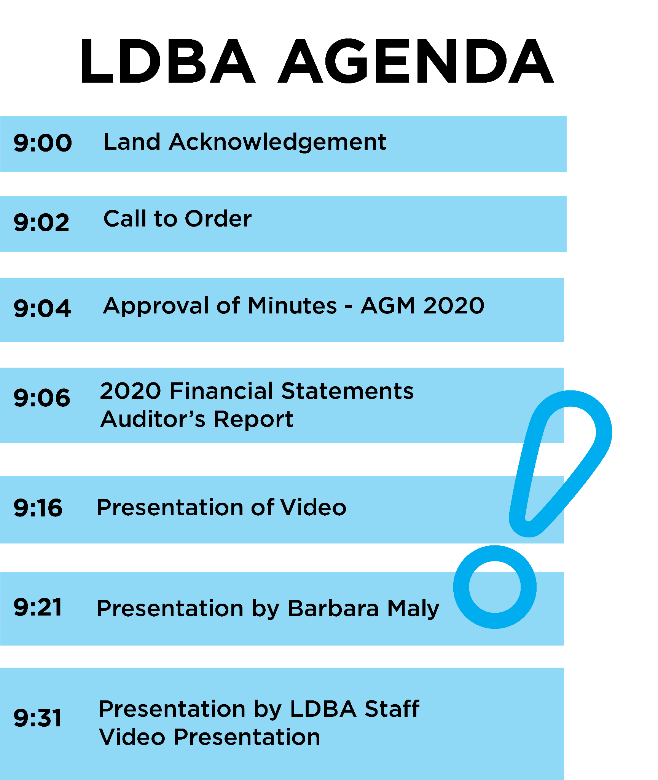
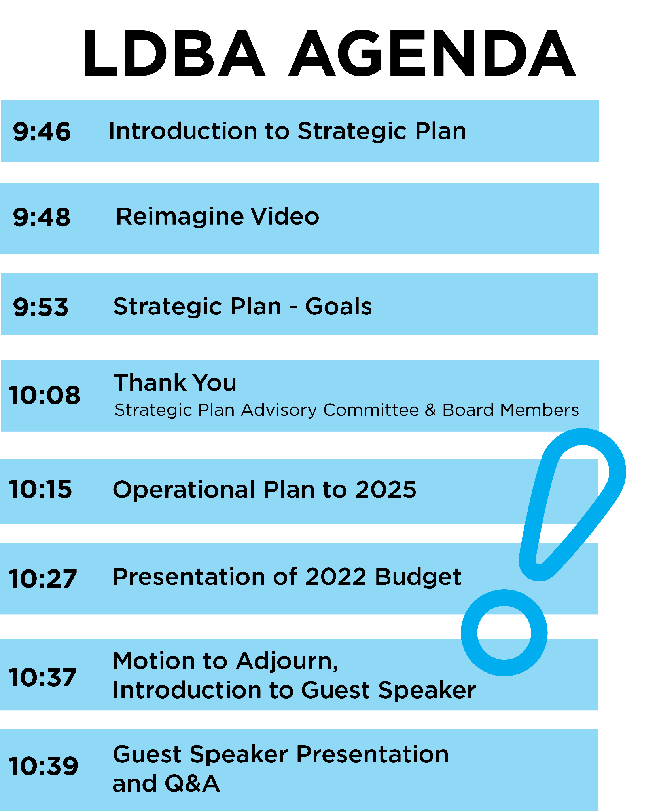
WELCOME

Slide 3
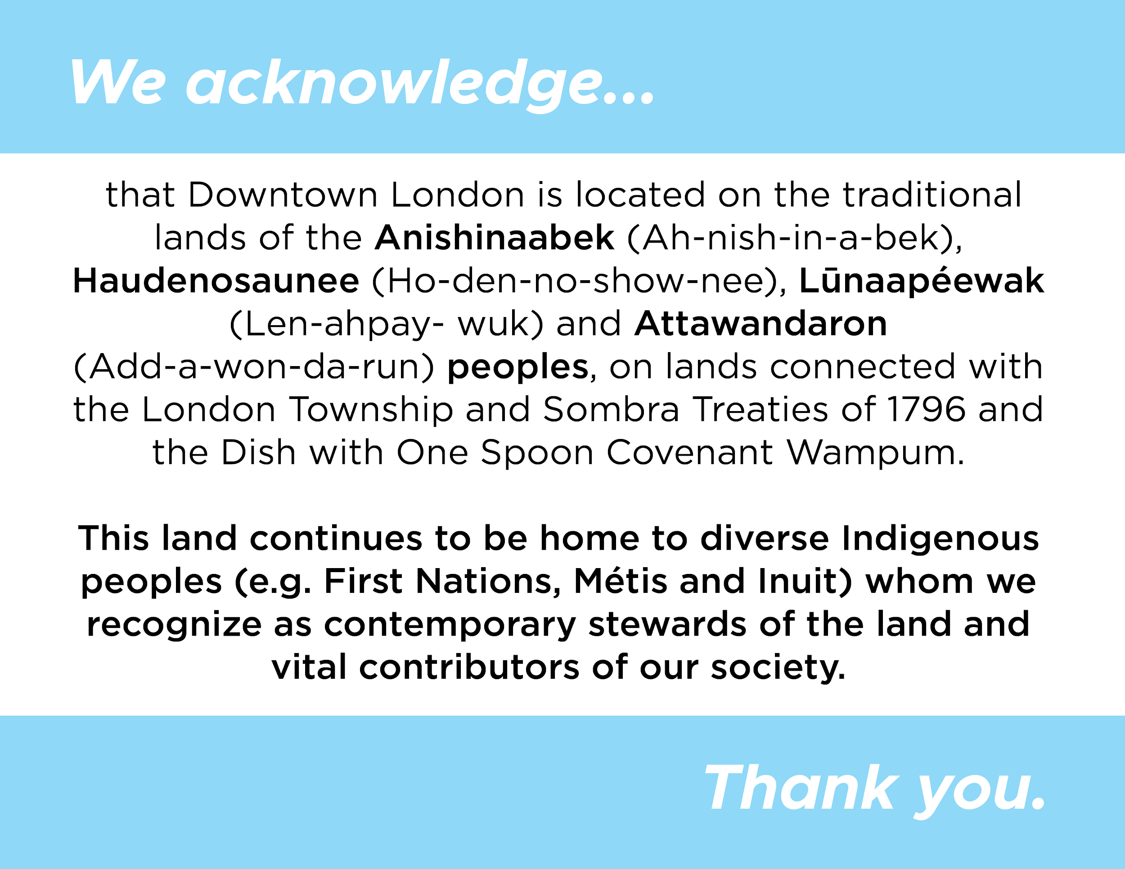

Slide 4


Slide 5
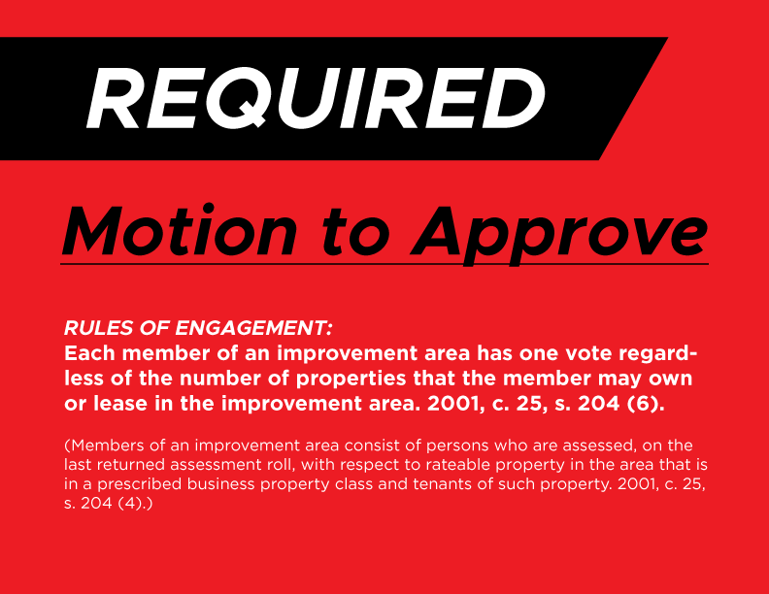

Slide 6


Slide 7
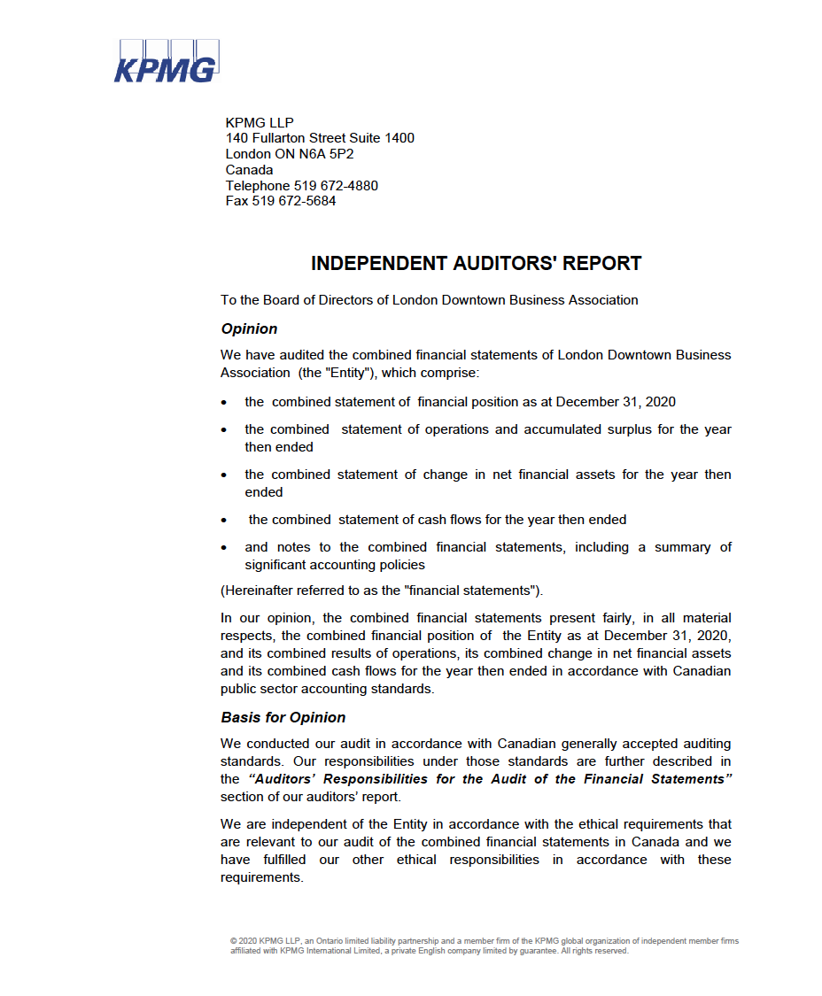
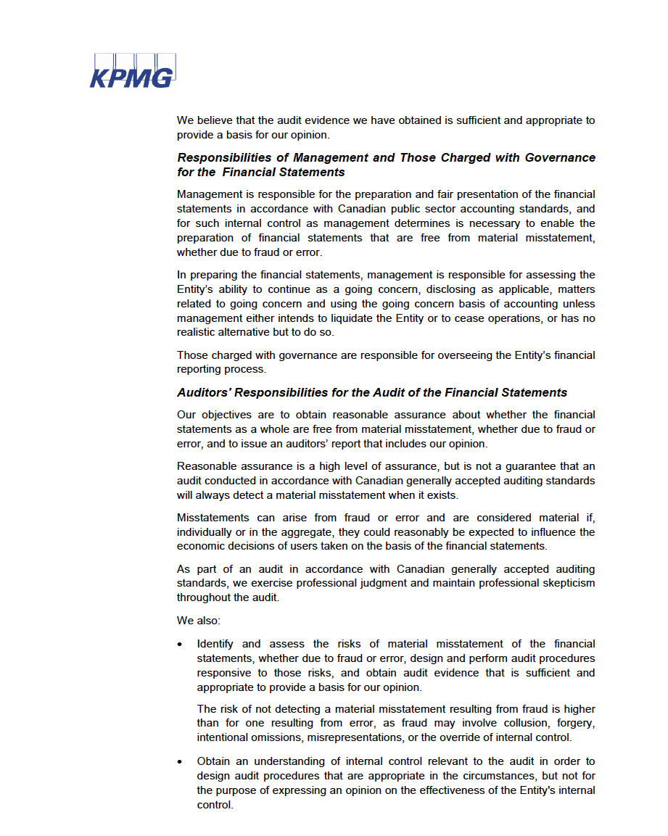

Slide 9
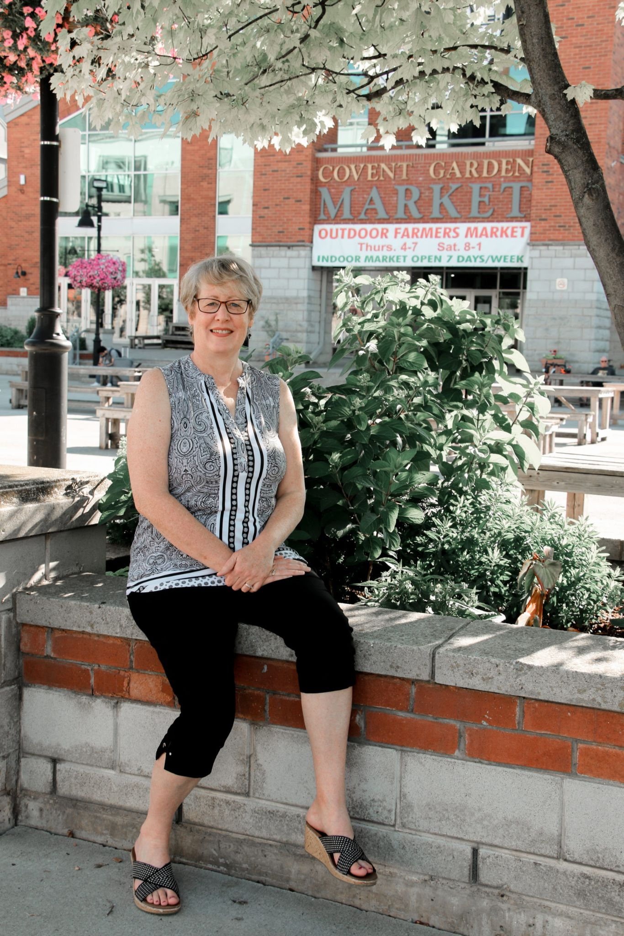
Barbara Maly
Executive Director, Downtown London

Slide 10
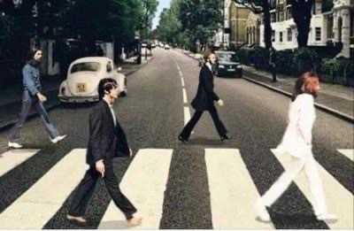

Slide 11


Slide 12






















Leveraging Partnerships

Slide 13
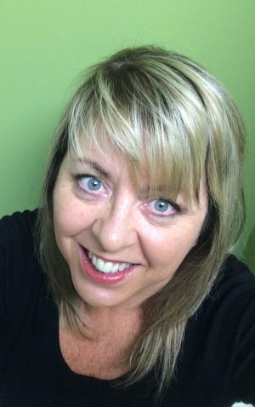
Congratulations on
your retirement, Lisa!

Slide 14
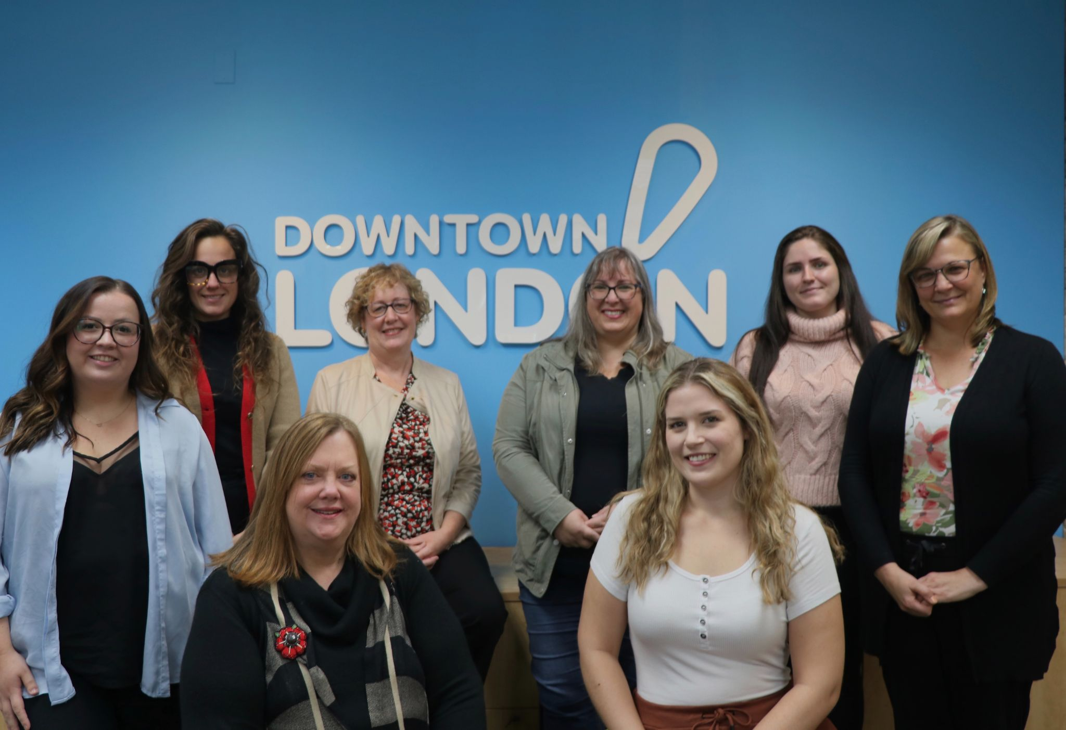
Meet the Downtown London
Team

Slide 15
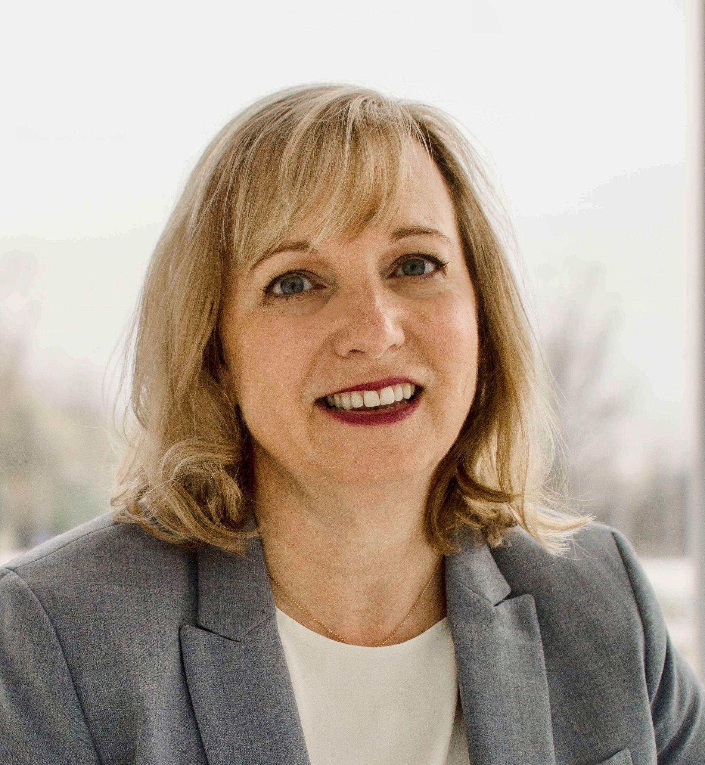

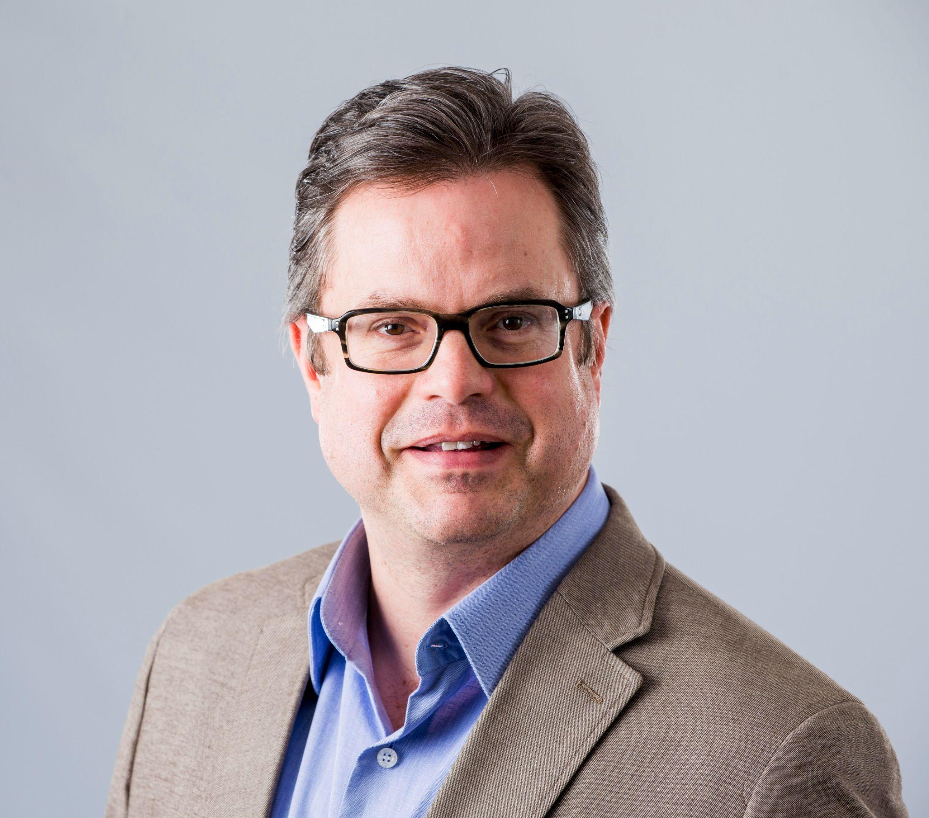
Aileen Murray & David Campbell

Slide 16



Downtown London Strategy
2021-2025

Slide 17


Goals of Strategy
Objectives
Build on previous efforts & successes
Recover and rebuild from impacts of COVID-19
5 year plan
Evolution of LDBA and MainStreet London mandates, priorities and actions
‹#›
Notes:
Aileen

Slide 18
Strategic Planning Process
Phase 1
Phase 2
Phase 3
Research & Analysis
Community Engagement
Strategy Development
Environmental Scan
Best Practices & Trends
Market & Member Analysis
Data Sources
Summary Report
Online Surveys
Stakeholder Interviews
Focus Groups
Summary Report & Strategic Priorities
Strategic Plan
Operations Plan
Executive Summary
Sector Profiles
Performance Measures
‹#›
Notes:
Aileen
Exhaustive literature review
Study of best practices in key areas of BIAs, downtown development, safety, and marketing
Comprehensive data analysis of economic and demographic trends, business counts and industry concentration,
and behavioural profiles of the downtown population
Market analysis and levies, CIP utilization
Review of downtown metrics by type and sources
Community Engagement
60+ interviews by consultants and staff
5 focus groups (initiation, staff, board governance, strategy & arts & culture), + strategic priorities meeting
2 surveys 174 Business members, 2300 community/ resident survey
SWOT Analysis & Strategic Priorities
Strategic Plan

Slide 19
Key Findings

Slide 20
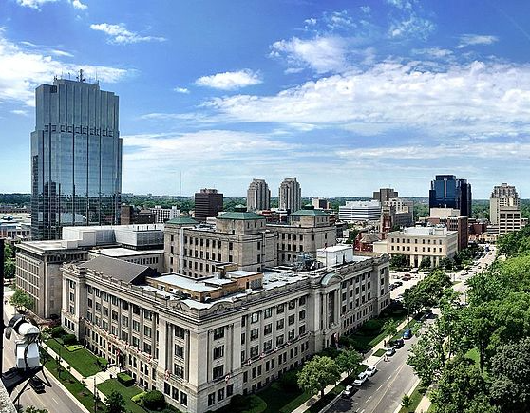
A Key City Asset
A critical contributor to the overall health and wellbeing of the city
Heart of city’s economy
Centre of cultural, recreational and social life
‹#›
Notes:
David

Slide 21
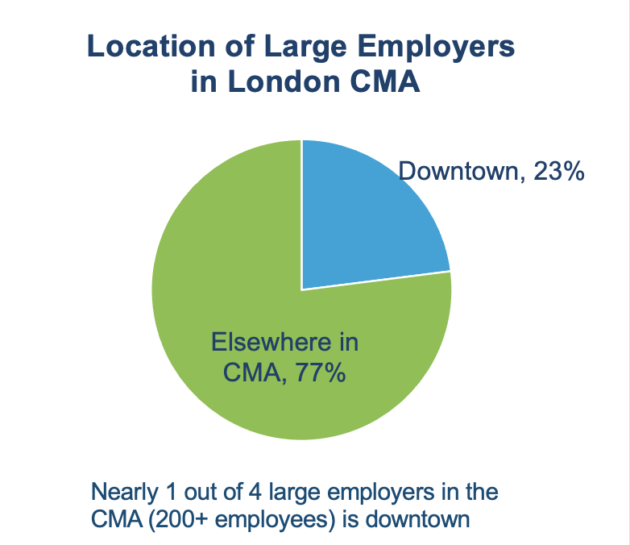
The Downtown Economy
1,485 employer businesses
in three Census Tracts (June 2020)
‹#›
Notes:
David

Slide 22
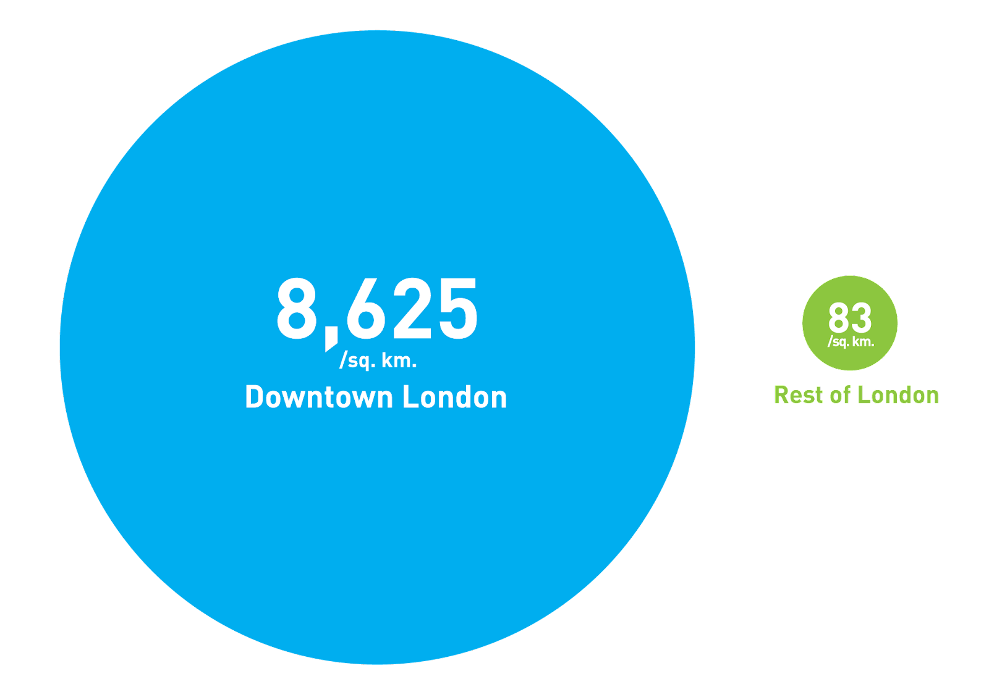
Concentration of firms and employment per sq. km., 2020
Source: Statistics Canada Business Location Counts, June 2020.
‹#›
Notes:
David
Downtown: 343 employer establishments per sq. km.
Rest of CMA: 5 employer establishments per sq. km.

Slide 23
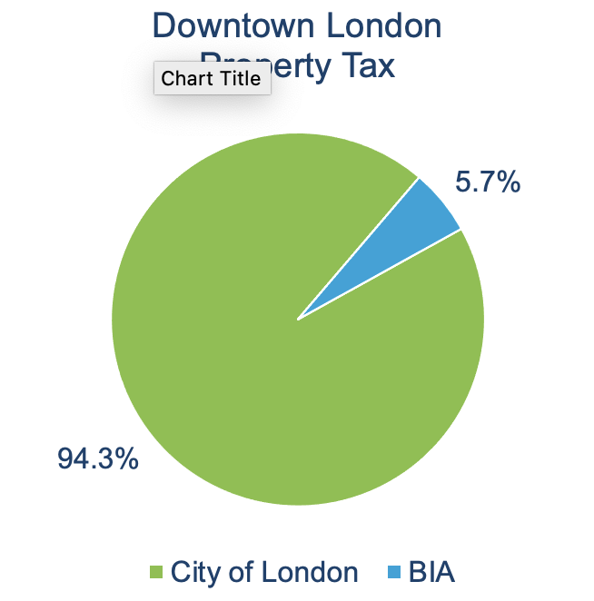
Downtown assessment
$887M Downtown BIA area assessment (2020)
5.7% of a downtown businesses’ property tax bill goes to the BIA.
94.3% goes to the City of London to fund public services.
Source: City of London
‹#›
Notes:
David

Slide 24


Growing Population
7,900 residents and 5,300 households (est.)
55% forecast population growth (2016 to 2039).
One of the fastest growing cities and urban centres in Canada
‹#›
Notes:
David

Slide 25
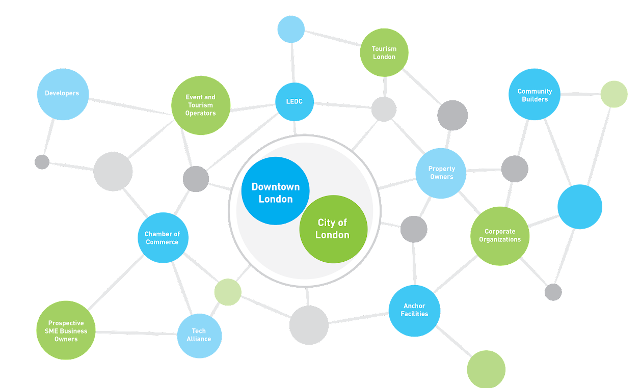
The Downtown Ecosystem
City of London
Anchors
Community Builders
Post Secondary Education
Arts & Culture Sector
Corporate Offices
Developers, Real Estate Professionals
Event Organizers
Other BIAs
‹#›
Notes:
David
Part of a dense network of partners and stakeholder that contribute to the downtown experience

Slide 26
Strategic Priorities
Support for a safe, welcoming environment
Diversified economic base
Focused governance
Strategic Priorities
Member Support
Strong partnerships
Downtown
champion
‹#›
Notes:
Aileen July 21 – met to discuss your strategic priorities.
Identified what needed to be addressed for Downtown London to be successful

Slide 27
Downtown London Strategy

Slide 28
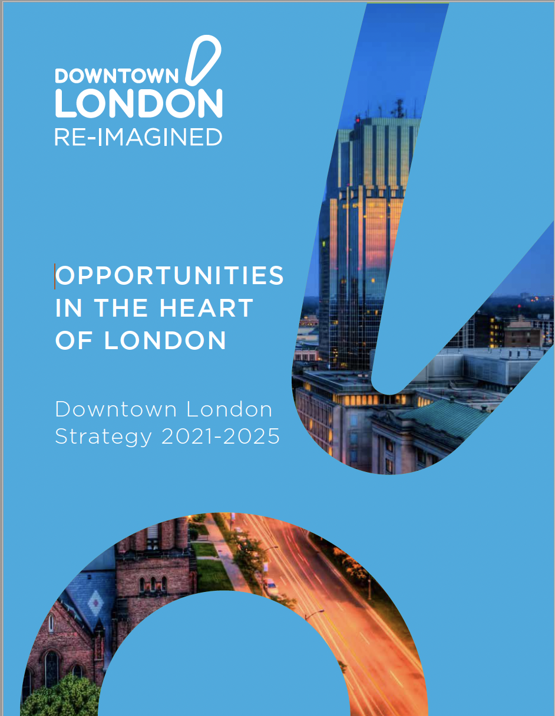
The Strategy
4 goals and related objectives
16 strategic directions
‹#›

Slide 29


Vision & Mission
Vision
Downtown London represents a thriving, progressive, and welcoming district in the heart of the city. The people that own businesses, visit, work, learn and live in the district are the essence of its vibrancy and diversity.
Mission Statement
Downtown London represents and supports its members, fostering a strong, thriving downtown in the economic and cultural heart of the city of London.
‹#›

Slide 30





Downtown London’s Values
Member Support
Leadership
Collaboration
Diversity
Prosperity
‹#›
Notes:
Member support: We assist our members to achieve success through promotion, programming and advocacy with a focus on the common good of the membership.
Leadership: We are uniquely positioned to speak as a catalyst for positive change, constructive advocate, and voice of the downtown.
Collaboration: We can achieve more by supporting and working cooperatively with our community partners on our shared goals.
Diversity: The variety and interplay of people, business, arts and culture in the district provides a richness of opportunity and experience unparalleled anywhere else in London.
Prosperity: The economic success of our members and the district reflects and impacts the economic health of the whole city.

Slide 31
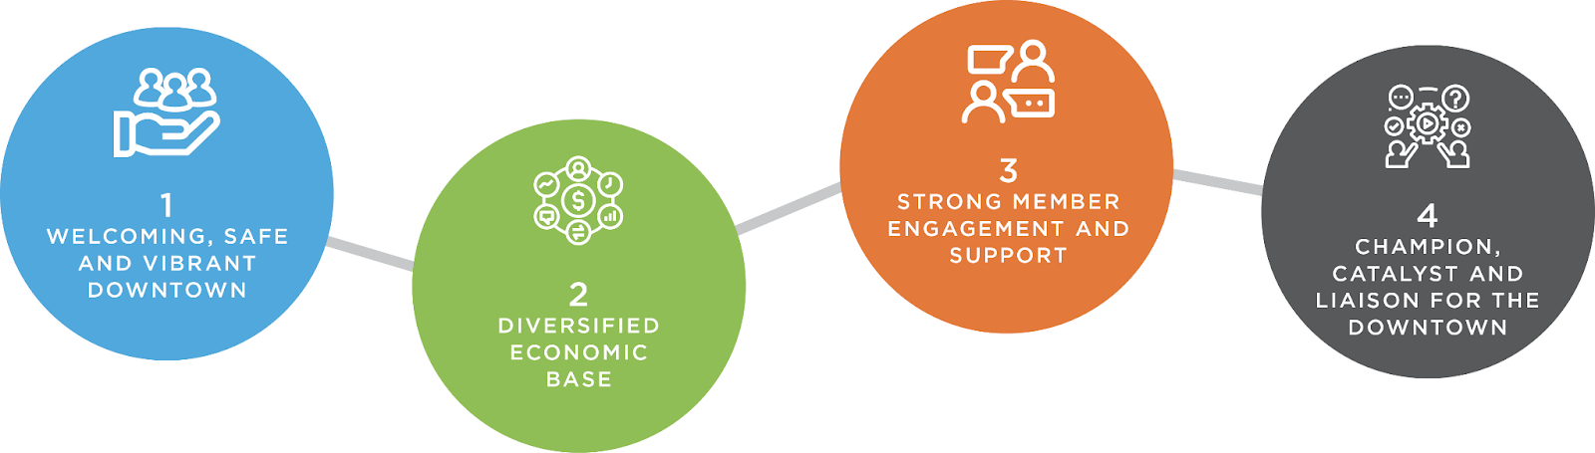
Downtown London’s Goals
‹#›
Notes:
Goals are the broad aim or end-result Downtown London wants to achieve in support of the vision.

Slide 32

Goal 1: Welcoming, safe and vibrant downtown
Objective | Plan and program efforts that provide an atmosphere that attracts and welcomes visitors and encourages new and continued business investment in the downtown.
Culturally diverse events and activations
Core Area Action Plan implementation
Sharing best practices
Better utilizing vacant storefronts
‹#›
Notes:
Objectives are the desired outcomes Downtown London wants to achieve as a result of the goal.
Strategic Directions are the foundational ideas or actions required to achieve the goals.
Barb will review

Slide 33

Goal 2: Diversified economic base
Objective | Grow and diversify the businesses, residents, services, and activities that contribute to the economic vitality of the district.
Downtown population
Business mix and investment
Business incubation & entrepreneurship:
students, BIPOC, startups
‹#›

Slide 34








Downtown Economic Diversification Targets
Residential | Health care | Retail | Restaurants
Education | Personal services | Arts, culture & entertainment | Accommodations
‹#›

Slide 35

Goal 3: Strong Member Engagement and Support
Objective | Align marketing and business assistance to amplify member success
Promotional support
Tracking/ responding to issues and opportunities
Member services, networking and information sharing
‹#›

Slide 36

Goal 4: Champion, catalyst and liaison for the downtown
Objective | Initiate and leverage collaborative efforts to advocate and achieve shared goals with organizations contributing to Downtown London’s success.
Strategic partnerships
Authority on downtown information and trends
Distinguishing Downtown London from the downtown district
Positive, professional brand
Advocacy plan
‹#›

Slide 37

Other Considerations: Governance
Establish MainStreet London and London Downtown Business Association as separate entities
Separate boards, mandates and meetings
Different but complementary organizations
‹#›
Notes:
Ontario Municipal Act restrictions appear to have changed.
We would encourage Downtown London to work with the City to define the legal considerations and develop an appropriate model to support investment attraction in the district

Slide 38




Thank you!
Aileen Murray B.Comm, Ec.D. (F)
Mellor Murray Consulting
mellormurray@gmail.com 519-784-7944
David Campbell, MBA
Jupia Consultants
david@jupia.ca 506-874-3797
Kevin Curtis, PhD, MCIP, RPP
Curtis Planning Inc.
kevin@curtisplanning.ca 519-500-9655
Tracy John
Amplify Marketing and Communications
tracy@amplifycommunications.ca 613-540-2125
‹#›

Slide 39
Thank
You
    Allan Drewlo - Drewlo Holdings
    Andrea Hibbert - London Arts Council
    Arielle Kayabaga - Former Councillor
    Asaad Naeeli - Dos Tacos
    Bonnie Wludyka - Citi Plaza
    Carmelia Tang - Main Street London
    Cheryl Finn - Tourism London
    Christina Fox - Tech Alliance
    D/Chief Trish McIntyre - London Police Services
    David Kirwin - Kirwin Fryday Medcalf Lawyers
    Don McCallum - Main Street London
    Graham Henderson – London Chamber of Commerce
    Jason Dickson - Brown & Dickson
    Jerry Pribil - Marienbad Restaurant & Chaucer’s Pub
    Jesse Helmer - Councillor
    Jim Bujouves - Farhi Holdings Corporation
    Jim Yanchula - City of London
    John Fleming - Western University
    John Fyfe Millar - on behalf of Two Wheels
    Jordan Detmers - on behalf of David E White
    Kapil Lakhotia - London Economic Development Centre
    Kathy Navackas - Main Street London
    Kelly Scherr - City of London
    Lori Da Silva - RBC Place London
    Michelle Giroux - Fanshawe College
    Nick Vander Gulik - Shoppers Drug Mart
    Scott Collyer - Empyrean LLC
    Steve Cordes - Youth Opportunities Unlimited
    Steve Pellarin - London Small Business Centre

Slide 40


Slide 41


Slide 42
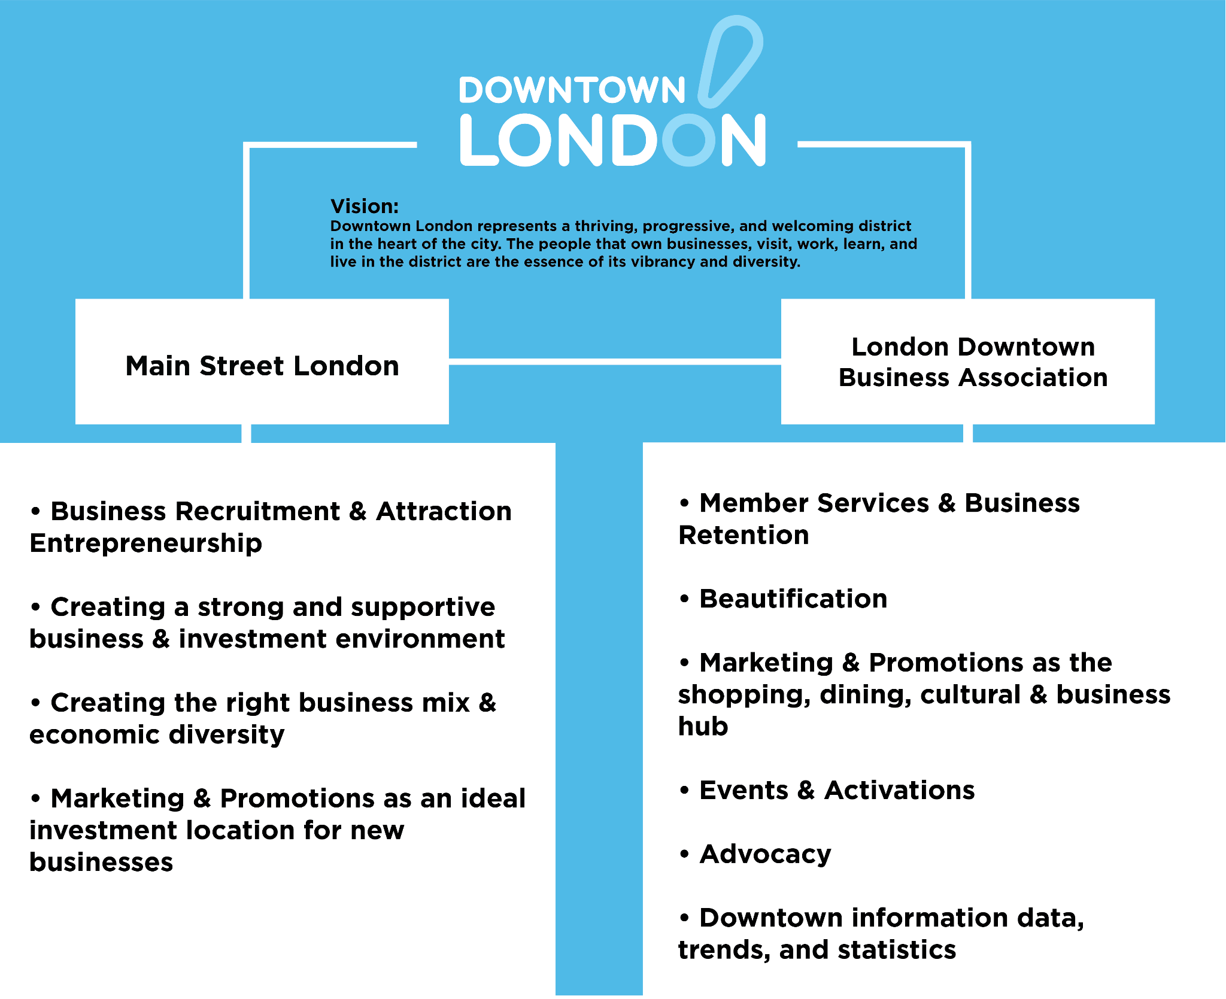

Slide 43
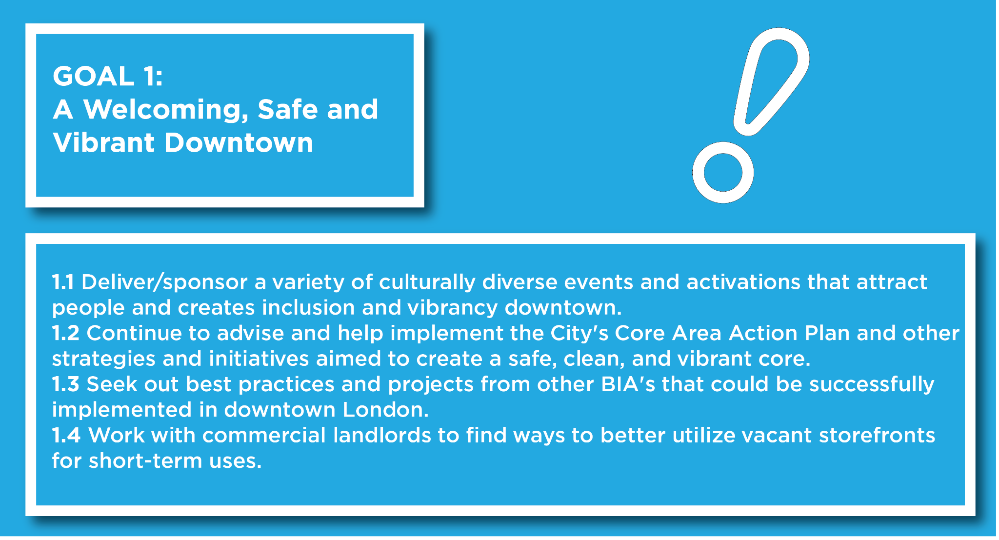

Slide 44
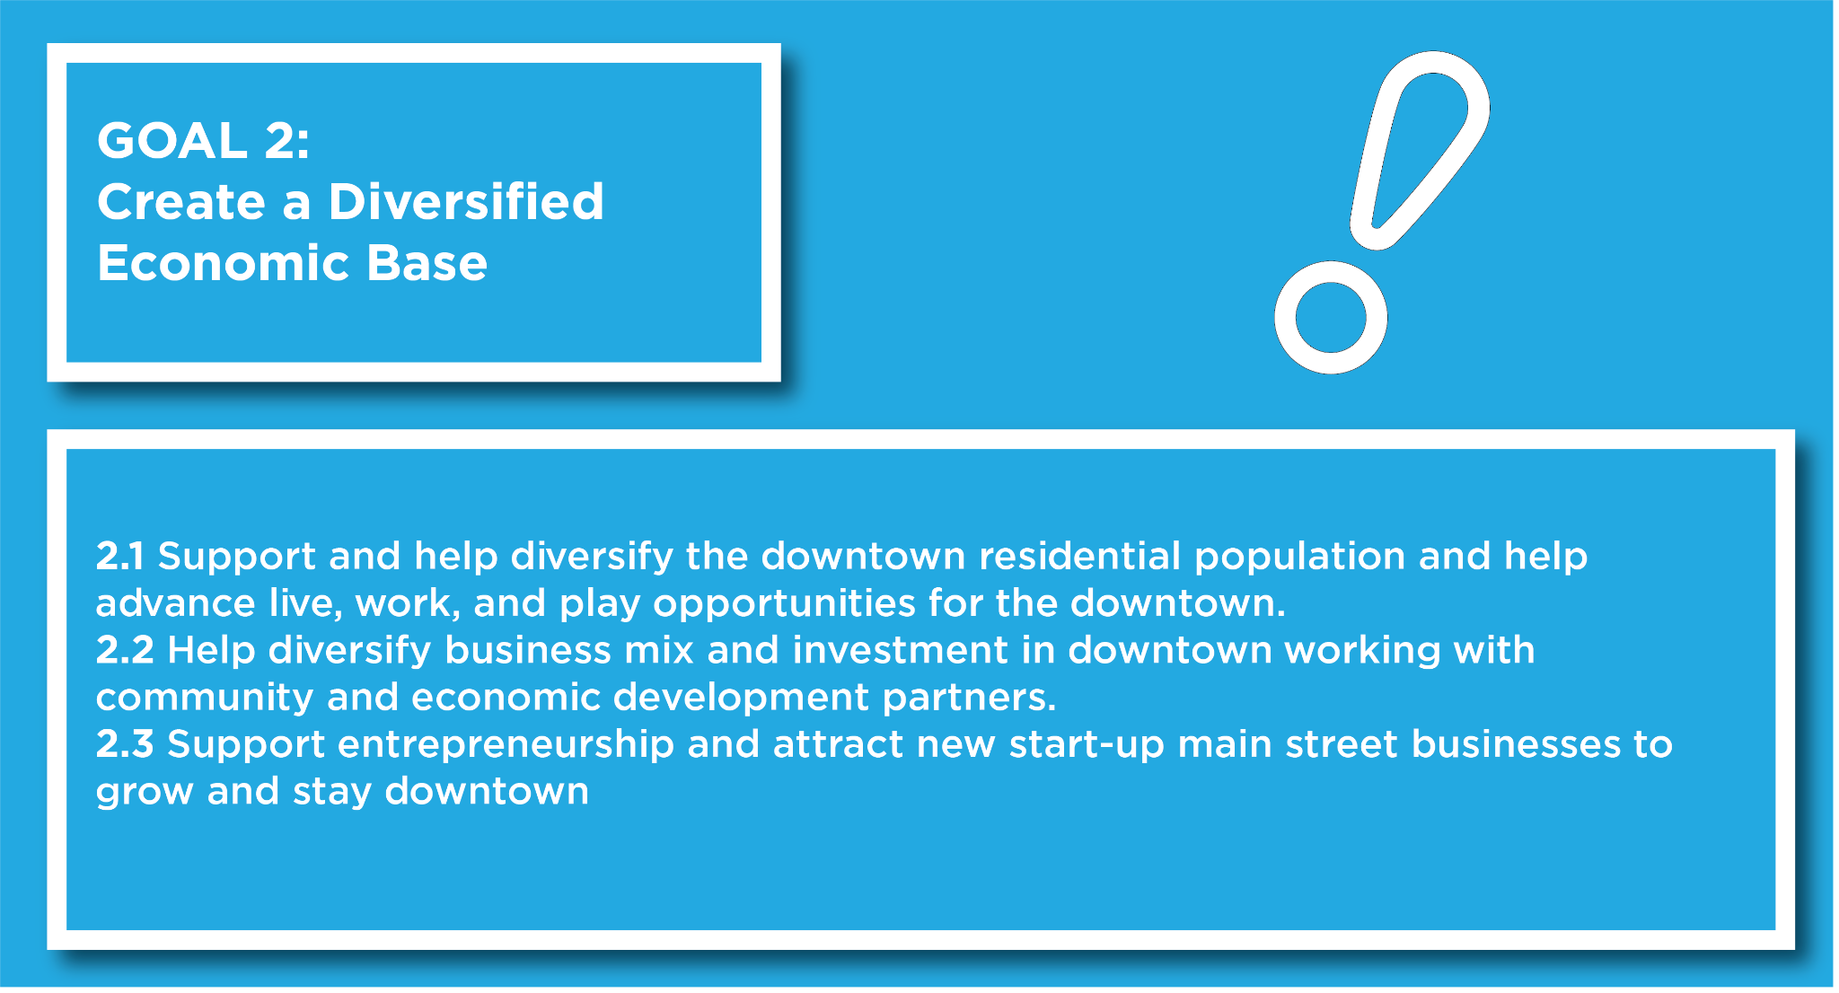

Slide 45
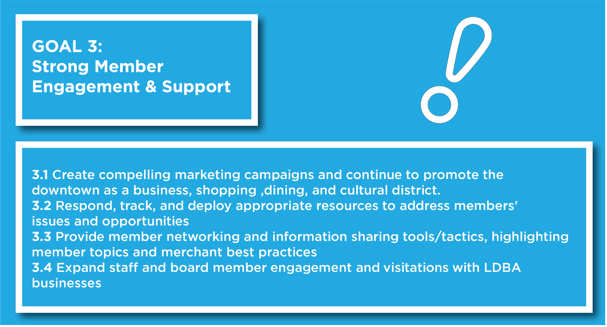

Slide 46
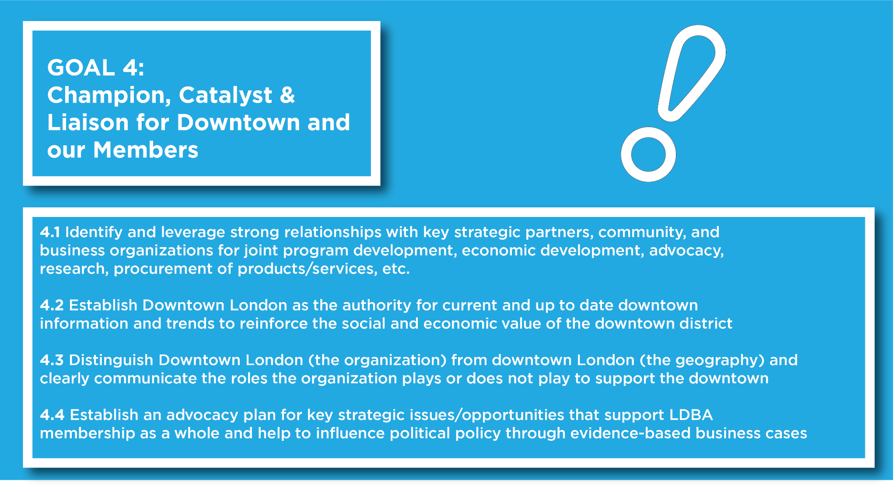

Slide 47


Slide 48
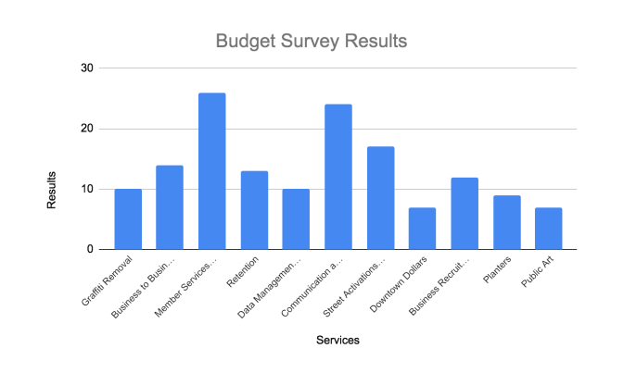

Slide 49
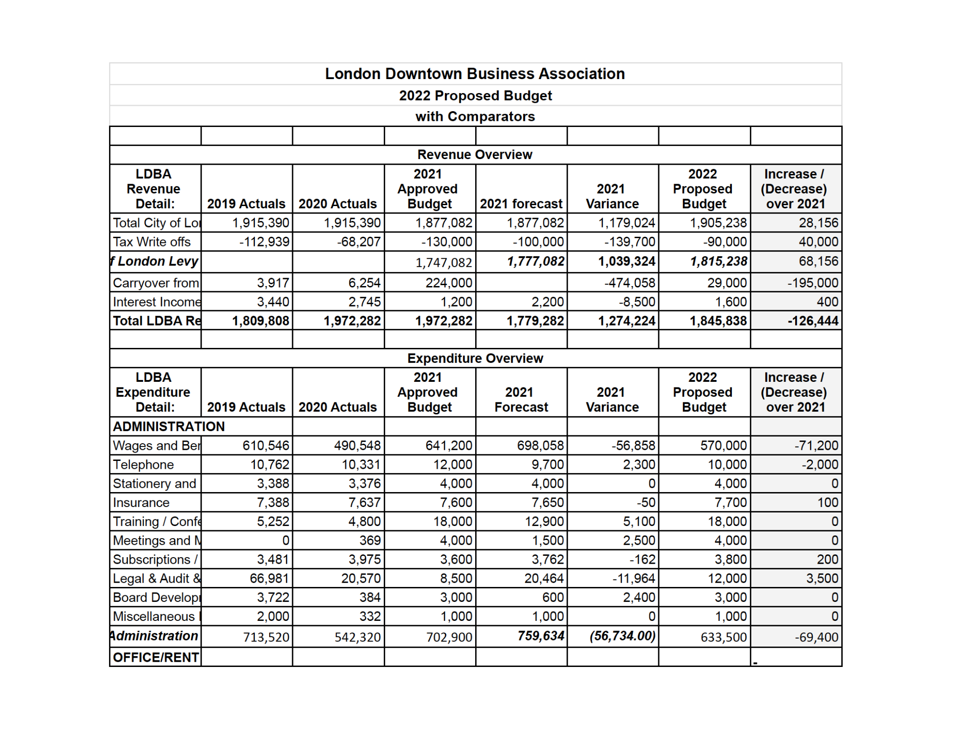
2021 Budget Presentation

Slide 50
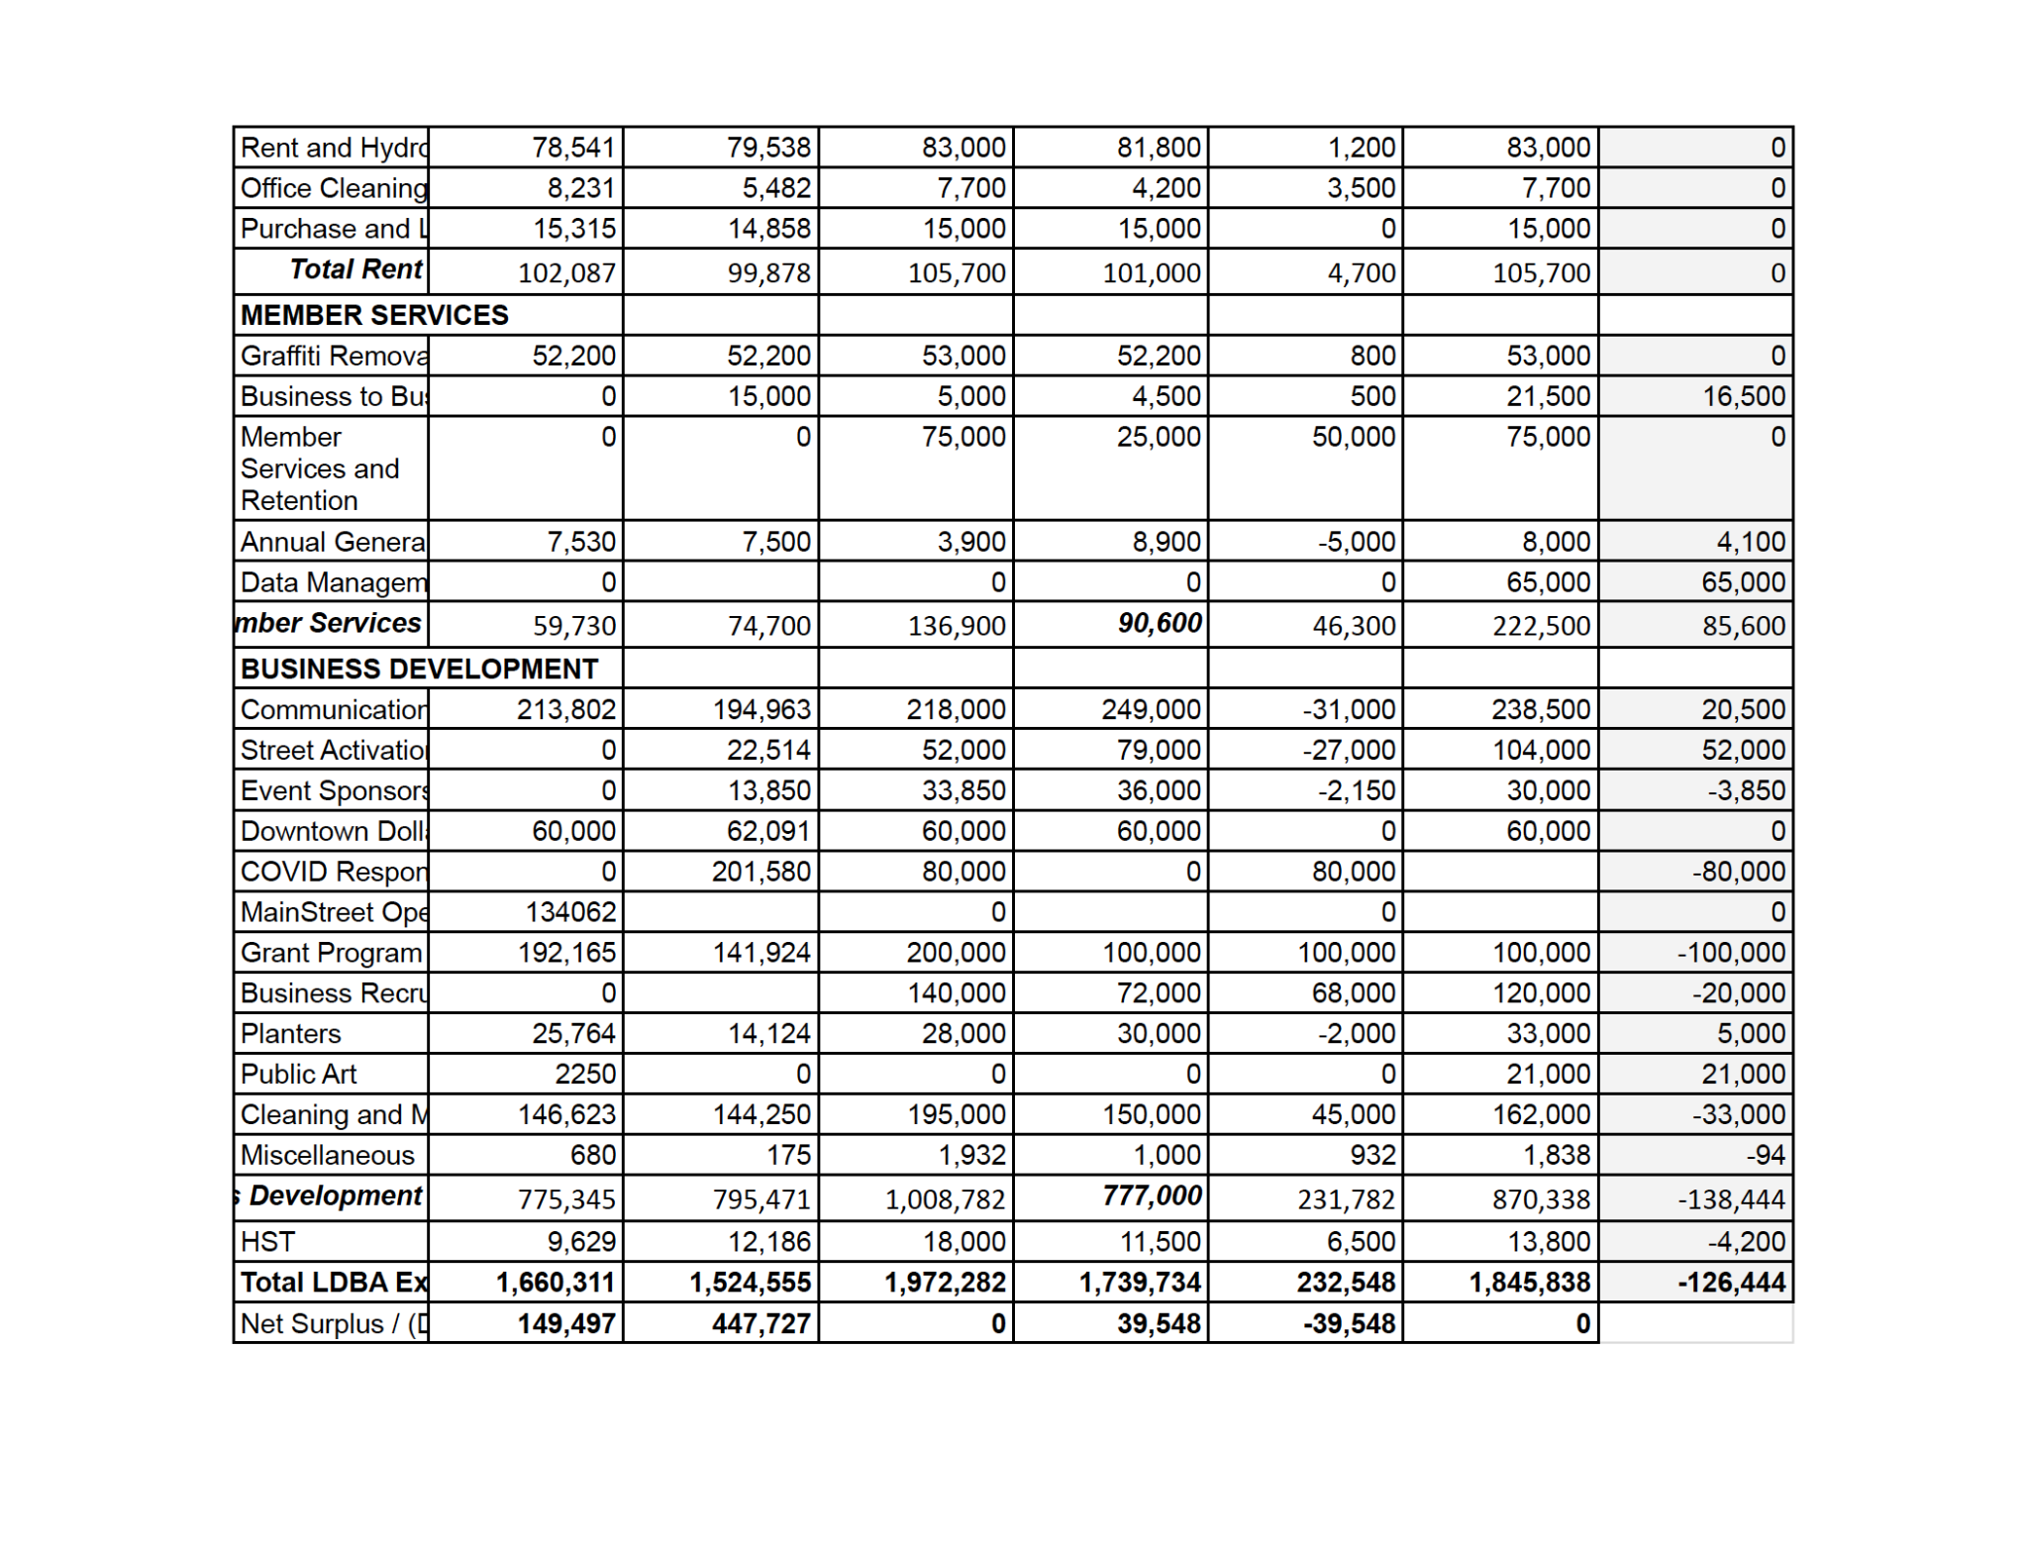
2021 Budget Presentation

Slide 51
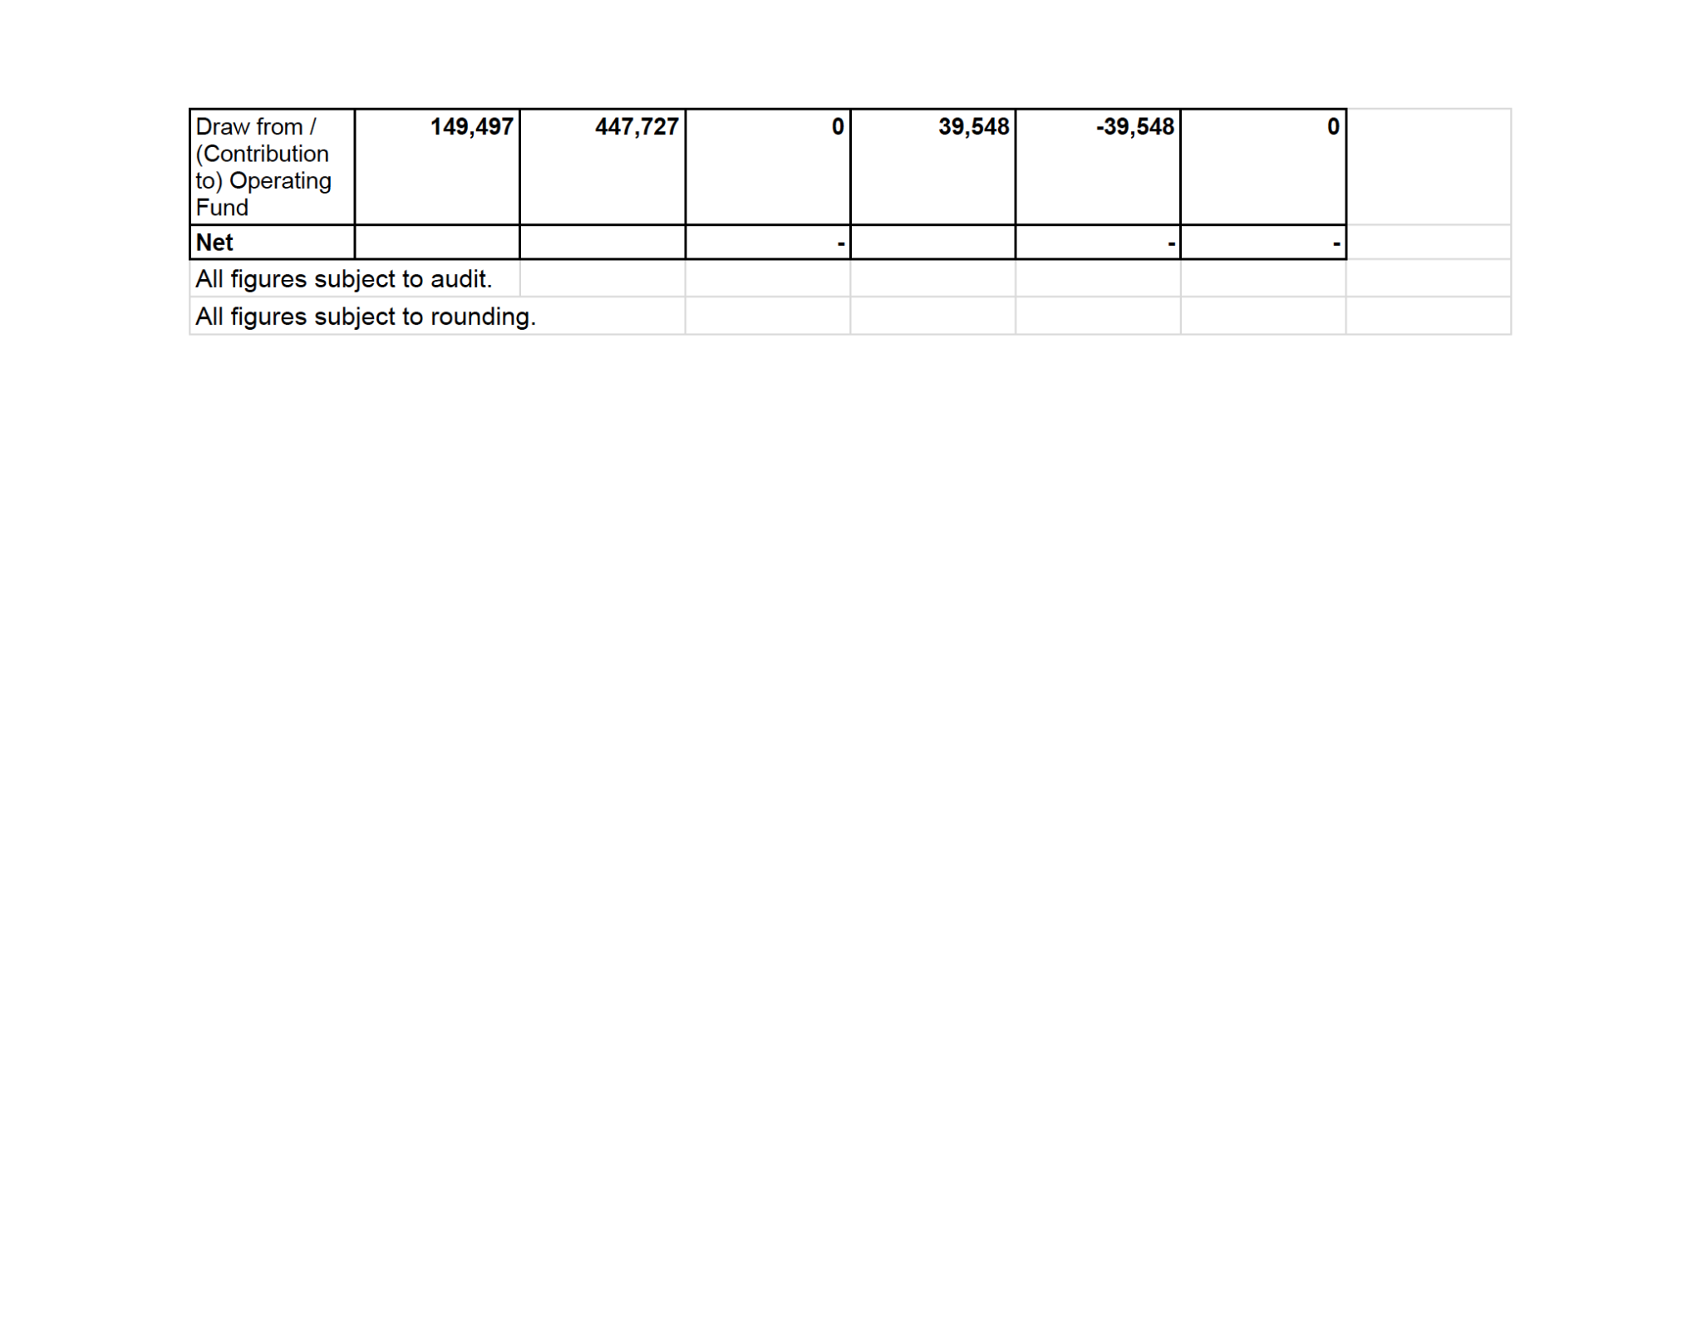
2021 Budget Presentation

Slide 52
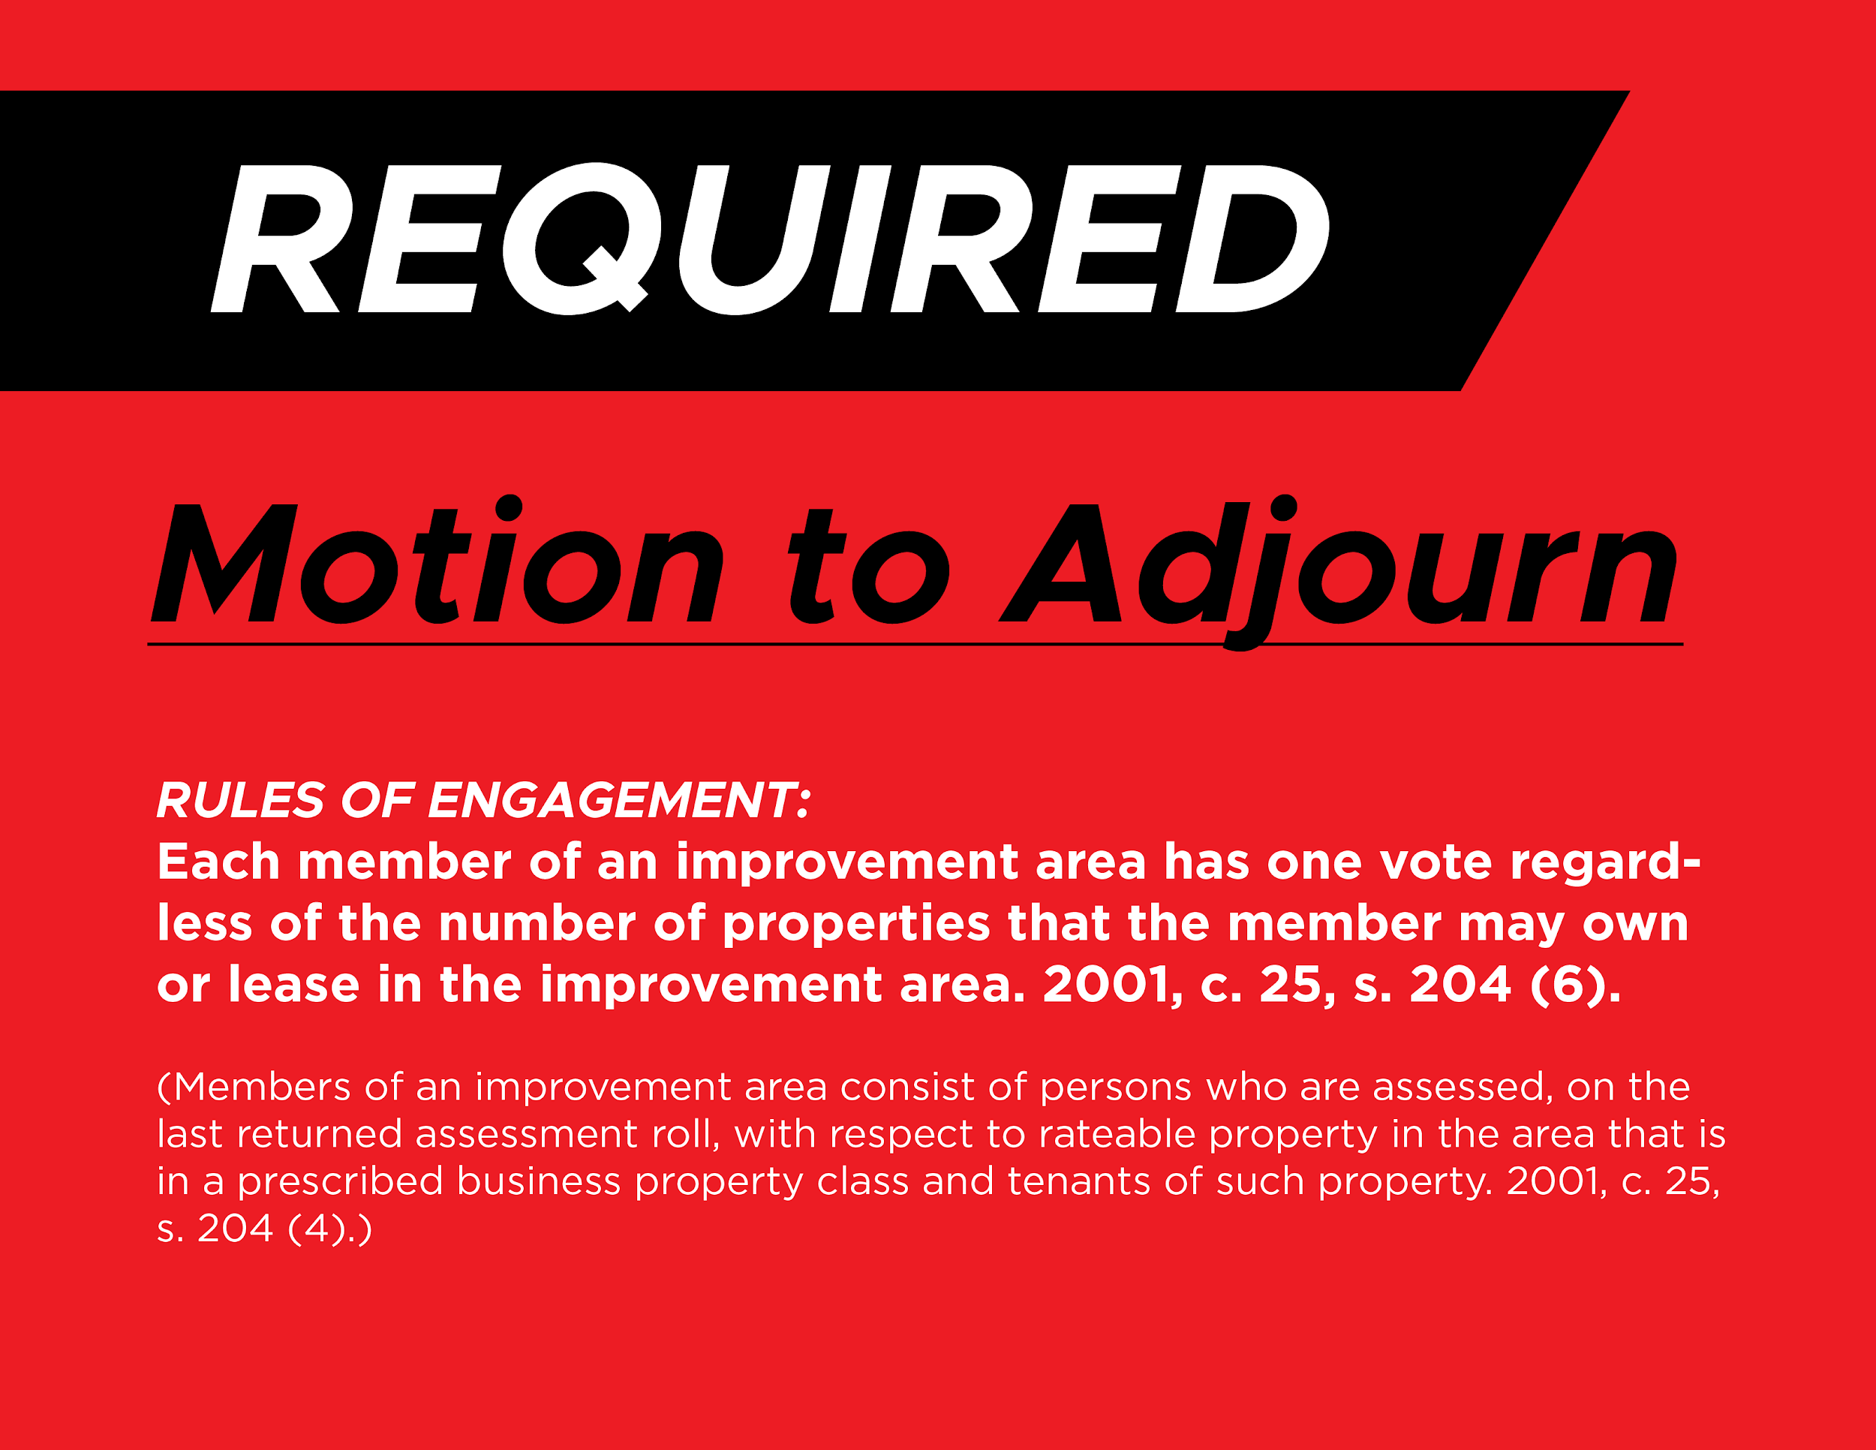

Slide 53
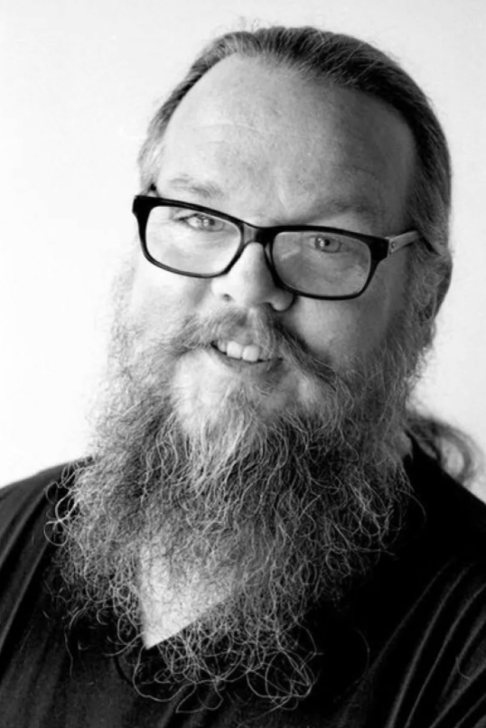
Iain De Jong
President & CEO at OrgCode Consulting, Inc.

Slide 54


